Slide 1
Selenium Automation with Java in Visual Studio
Project Overview and Key Insights
By Balota Grigore Alexandru

Slide 2
Websites tested were Emag.ro and Dedeman.ro
On Emag we tested the main pages, with some peculiar tests on each main menu page and finishing with some product manipulation like adding to favorites and attempt to checkout a product. We will use JUnit testing framework (or TestNG)
On dedeman.ro we did a login with a pre-existing account but using Behavior-Driven Development (BDD) syntax, and specifically, a feature file written in Gherkin using frameworks like Cucumber

Slide 3
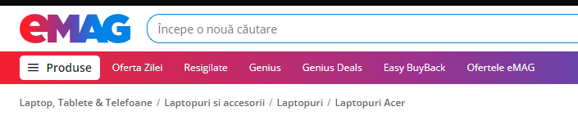
Emag.ro
As mentioned we are testing all available menu pages and at that time those were:

Slide 4
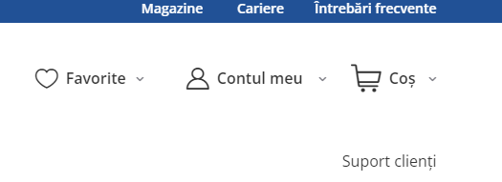
Dedeman.ro
As mentioned, we will do a login on the main page in Contul meu but using Scenario Outline, more about this later.

Slide 5
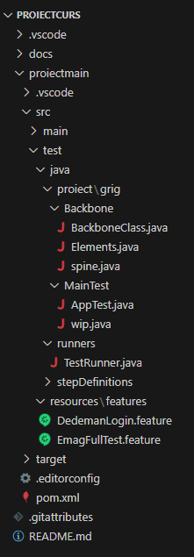
Main project overview
This is how the structure of the project looks.(look to the right)
As mentioned we have a combination of JUnit (or TestNG) Testing Framework found in AppTest.java file.
As the project grew we naturally started implementing OOP in the project. Simply put, what i mean by that is creating Helper methods (small, reusable functions that simplify complex tasks) and @FindBy in a separate file to locate elements, ensuring they can be accessed throughout the entire project, reducing duplication and improving code clarity.
Behavior-Driven Development (BDD), represented by the .feature files(the green ones), stepDefinitions and TestRunner java files. It uses Gherkin syntax to write tests in natural language (e.g., "Given", "When", "Then").

Slide 6
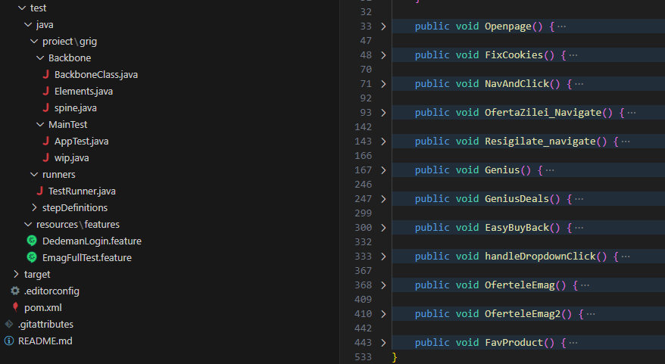
Let’s get dirty And looks over the code in detail
We will start with the BackboneClass.java
This is where most of the magic happens
You can consider each method a test , although keep in mind some are a bit bigger and complex then others.

Slide 7
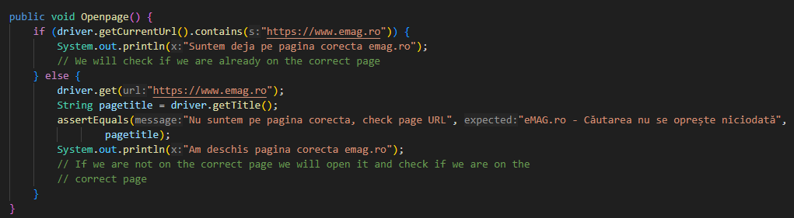
Let’s start with OpenPage()
Short answers, in order, are:
We need to open the web page to start any testing
Remove load times
Reduce code duplication
Allow other tests to run independently or in combinations
Helps us figure out quickly the code function
The assertion makes it a test not a helper method
Why do we start here?
Why do we have an IF there?
Why do we have comments?
Why do we have assert?

Slide 8
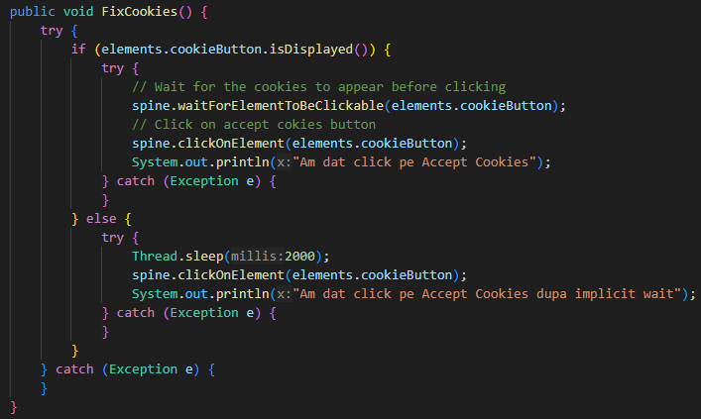
FixCookies()
Why is this in a try catch?
Why also an IF again?
Try catch:
Because the way i wrote all the other tests and code makes this an optional method because accept cookies will not impose on any test and can be ignored on this website
I incorporated this method in all other tests along with OpenPage() to give them self-reliance
If this “test” fails the test run should continue and not fail/stop.
If again:
While the first option proved to be reliable in testing so far, we still have a backup with implicit wait that was the initial solution
Notice helper method and element.

Slide 9
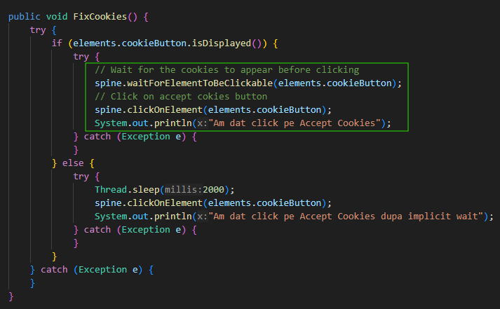
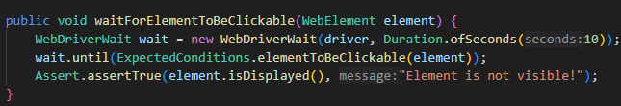

Let’s take a quick detour and talk some OOP
Helper methods(spine.java)
Elements.java
Reason OOP happened (quick storytime)
Losing track of what elements did what specific code did and the backtracking needed to understand what needed to be fixed when a selector was not working, in short the extra troubleshooting
Notice Assert

Slide 10
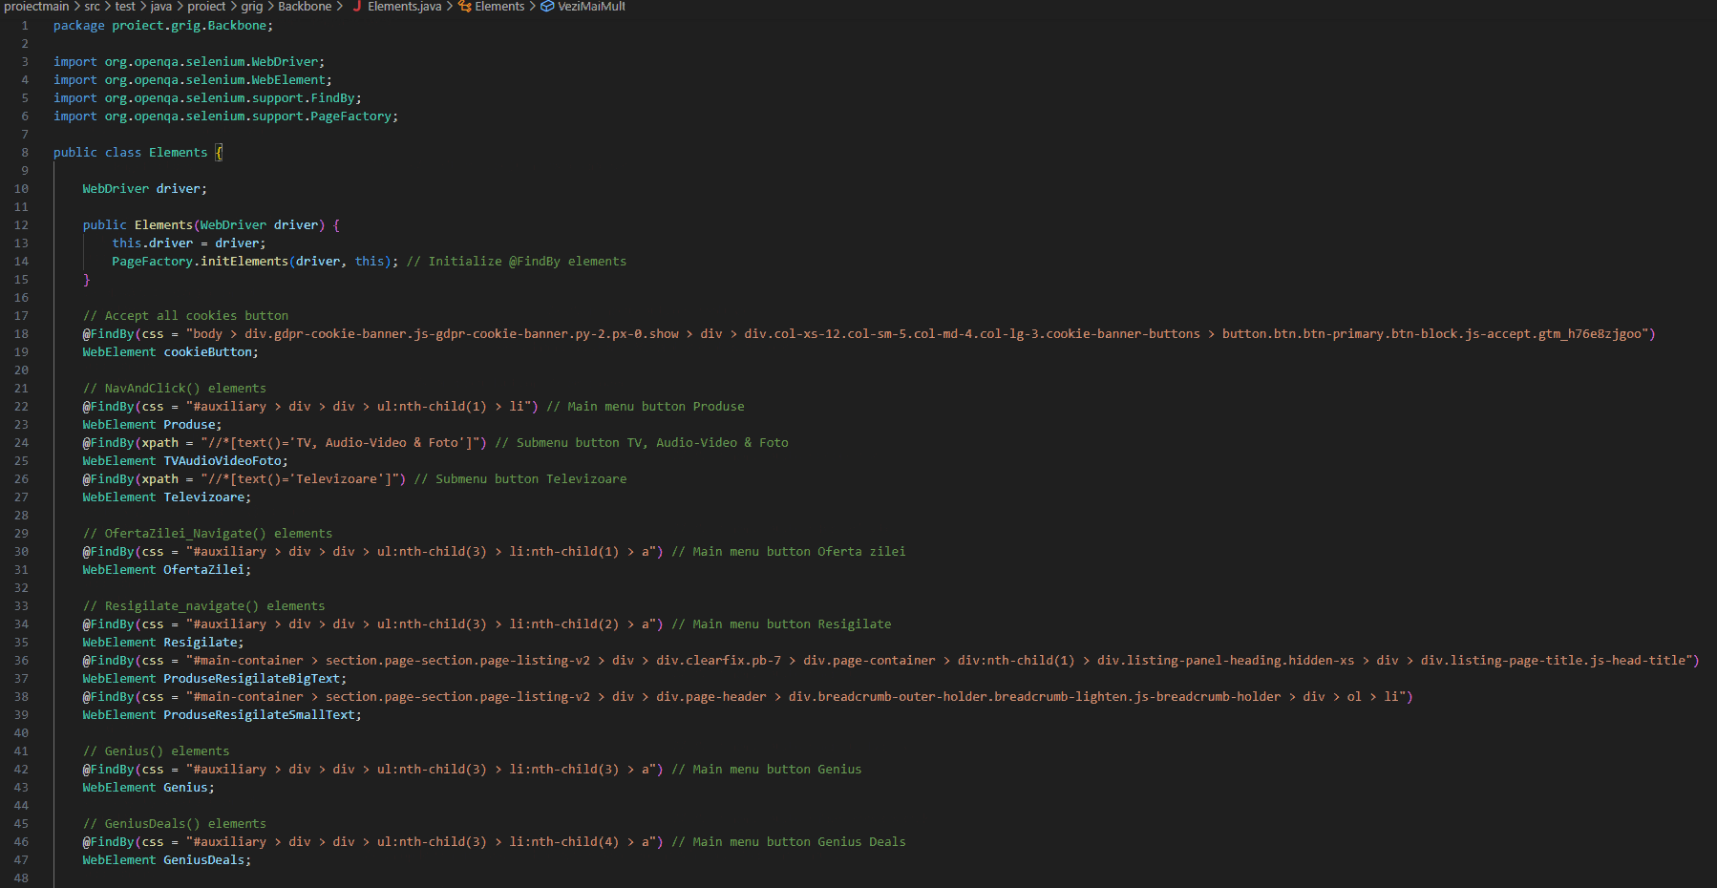
@FindBy(locator) WebElement cookieButton
This annotation is used to locate the "Accept all cookies" button on a web page using a CSS selector. By storing the element in a variable (cookieButton), you can easily access and interact with it throughout your project.
Advantage:
It improves code readability and maintainability by centralizing element locators in one place. This reduces duplication, making updates easier (e.g., if the button’s CSS changes, only one place needs to be updated).

Slide 11

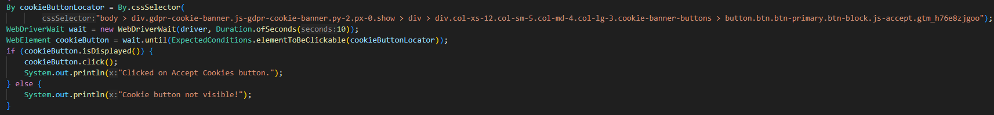
Let’s compare the code with and without the OOP , raw
Quick note: keep in mind just one helper method similar to the one shown is used over 15 times in the whole project
Vs

Slide 12
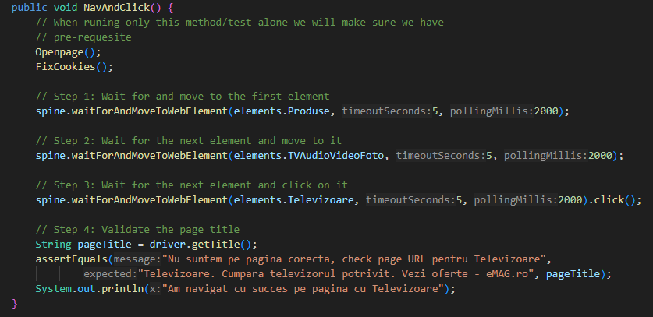
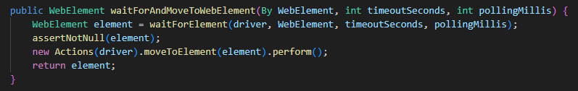
Detour over, NavAndClick() is next
Notice OpenPage and Fixcookies
While a simple test, we had the opportunity to navigate using hover since this is the intended way to navigate the Produse page and click on Televizoare.
We navigate and click on the last element then validate we are on the correct page
Notice how clean the methods code is and the comments that summarise the codes function

Slide 13
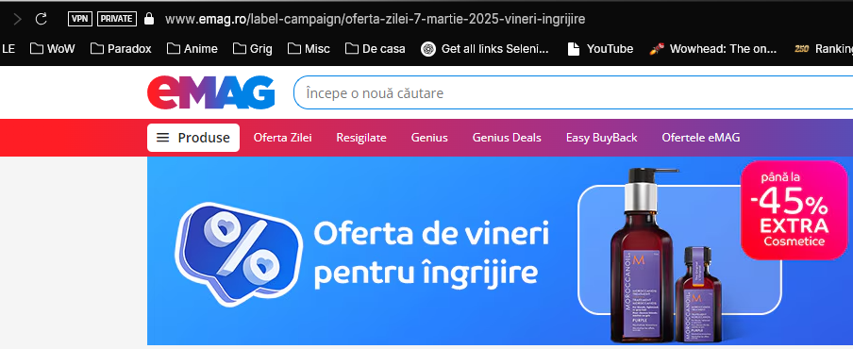
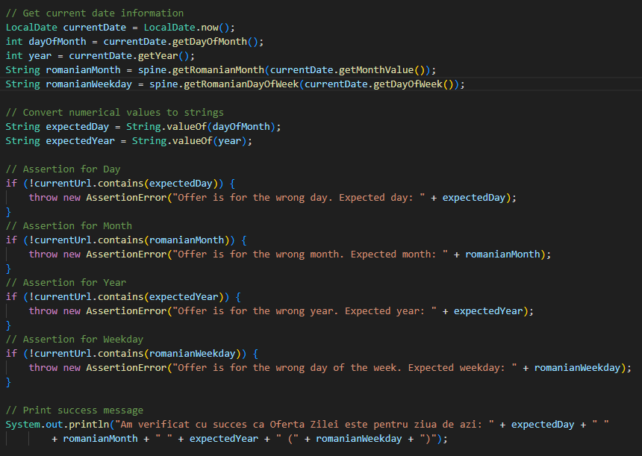
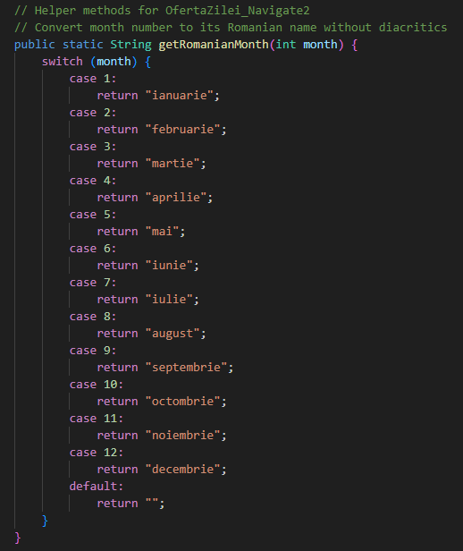
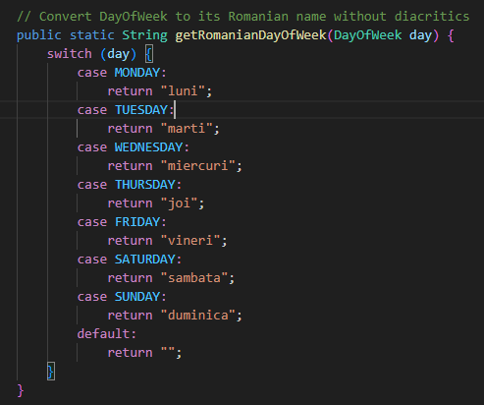
OfertaZilei_Navigate()
Notice the URL
This page has an offer that changes daily so i decided to check if the offer is for current day, dynamically
This means that any time you run the test we will check if the offer is for that day
This method is a big bigger in scope and size
We also have 2 helper methods

Slide 14
Let’s run it once in VS !
We’ll pause, change to VS studio for a bit and touch upon visually on OOP elements by showcasing the spine.java file and elements.java

Slide 15
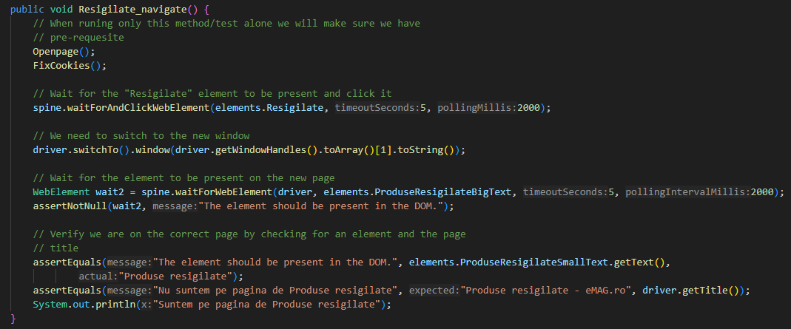
Resigilate_navigate()
What is particular about this menu page is that it will open in a separate tab so the highlight is doing a swap to that second tab to continue the test

Slide 16
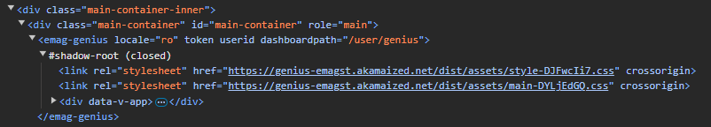
Genius()
What is most interesting about this page is that almost all of it page is under a shadowroot
Also, we will:
Scroll to a specific element to make it visible(we are not maximizing the browser)
Play with some sliders, moving one of them and changing the sum we are estimated to save if using the genius service
Shadow DOM (or shadow root) is like a mini hidden webpage inside a webpage. It lets web developers create parts of a webpage that are isolated from the rest, meaning normal CSS and JavaScript can’t change them unless accessed correctly.
For Selenium, this means you can’t directly find elements inside a shadow root using normal locators.
Instead, you have to:
Find the shadow host (the element that contains the shadow root).
Use JavaScript to access the shadow root.
Locate elements inside the shadow root.
The root , THE SHADOWROOT

Slide 17
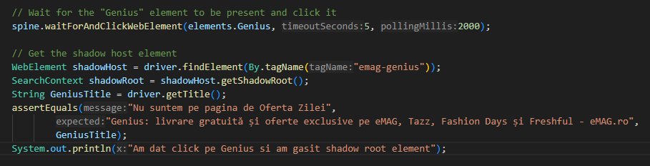
No @Find in shadow dom
The main challenge is to find the element containing the shadow root
In out case it’s a simple (By.tagName(“emag-genius”))
Now let’s go a bit more into detail
Because we can’t use elements.java we can compare this code to the rest of the project while showcasing how to find elements using shadow root
Swap to VS again after explaining the code a bit more

Slide 18
Explanation of the Code:
Find the shadow host → driver.findElement(By.tagName("emag-genius")) locates the element that contains a shadow DOM.
Access the shadow root → shadowHost.getShadowRoot() retrieves the shadow DOM, allowing interaction with its internal elements.
Elements inside a shadow DOM cannot be accessed directly with normal Selenium locators. You must first get the shadow root before interacting with them.
WebElement shadowHost = driver.findElement(By.tagName("emag-genius"));
SearchContext shadowRoot = shadowHost.getShadowRoot();

Slide 19
Find the button inside the shadow DOM → shadowRoot.findElement(By.cssSelector(...)) locates the "Încearcă gratuit 3 luni" button inside the shadow DOM.
Click the button → spine.clickOnElement(elm); triggers a click on the located element using a predefined method from the spine class.
Since the button is inside a shadow DOM, you must first retrieve the shadow root before using findElement()
// Click on the "Încearcă gratuit 3 luni" button
WebElement elm = shadowRoot
.findElement(By.cssSelector("div > div > div.main > div > div:nth-child(5) > button"));
spine.clickOnElement(elm);
System.out.println("Am apasat pe primul buton Încearcă gratuit 3 luni ");

Slide 20
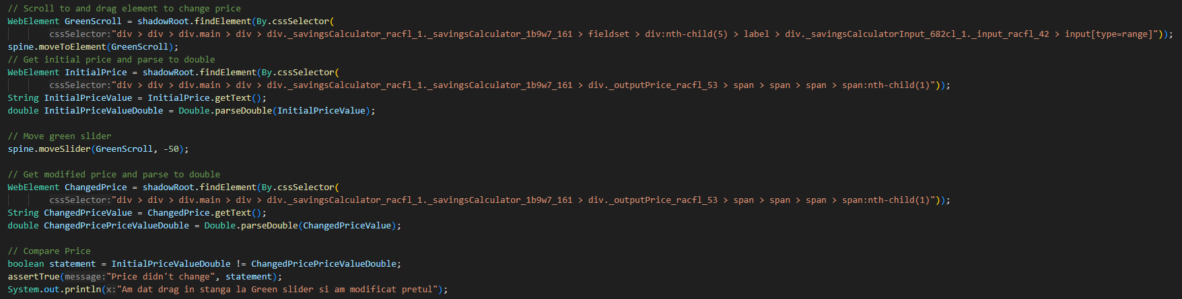
Let’s VS
Check out the method
Explain the rest of it showcase moveSlider in spine.java
Run it one
Here is a snippet of what we will look at next in VS

Slide 21
GeniusDeals()
There wasn’t much happening on this page at first and i almost removed the test but i did notice something interesting
The URL: https://www.emag.ro/label-campaign/genius-deals-3-9-martie-2025?ref=hdr_genius-deals
Similar to Oferta zilei but slightly different.
On Oferta zilei we knew what we need to check, the current date vs, well, current date in the url. It’s predictable.
This one is in a range and we don’t know for sure what range of days the offer will be for.
But we can notice that we do have the start day and end day in that string, so i had an idea
There must surely be a way to get only numbers out of a string right?
Challenge accepted!

Slide 22
Long story short
Of course we can (explain a bit more why i needed to extract the numbers from the url)
After looking up solutions online i found what i needed
Well you can guess who won in the resource department and troubleshooting solutins
Forums vs ChatGPT ; well yha GPT won
I took the solution , applied it and it worked like a charm
But then i had to understand also what i did there myself in more detail

Slide 23

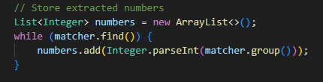
It was regex
Info Regex
What is Regex (Regular Expression)?
Regex (Regular Expression) is a sequence of characters that defines a search pattern. It is used for string matching, searching, extracting, and replacing text in a flexible way.
How Regex Works (Step by Step)
Define a Pattern – You create a rule using special symbols.
Apply the Pattern – The pattern is used to match, extract, or replace text.
Process the Matches – You use the result for validation, searching, or transformation.
The Pattern.compile("\\d+") creates a regular expression (regex) pattern.
\\d+ means:
\\d → Matches any digit (0-9).
+ → Means "one or more" of the preceding character (digits in this case).
So, this pattern will find all sequences of numbers in the string.
Matcher matcher = pattern.matcher(url);
pattern.matcher(url) creates a Matcher object that will search the URL for occurrences of numbers.

Slide 24
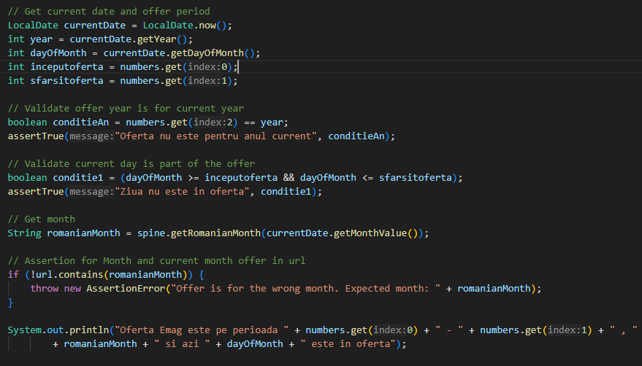

Slide 25
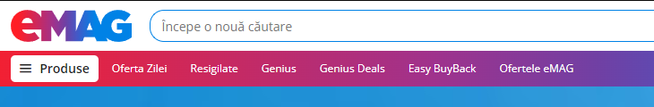
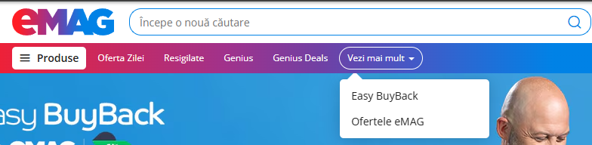
EasyBuyBack() & OferteleEmag()
This two pages really didn’t had anything interesting going on going for them to set them apart
Well, that would be the case if i was testing with a maximized browser window but..
I wasn’t .. and i’m glad i wasn’t
That that simple fact did make them interesting compared to the rest
We have a dropdown when we are not testing in a maxed out browser

Slide 26
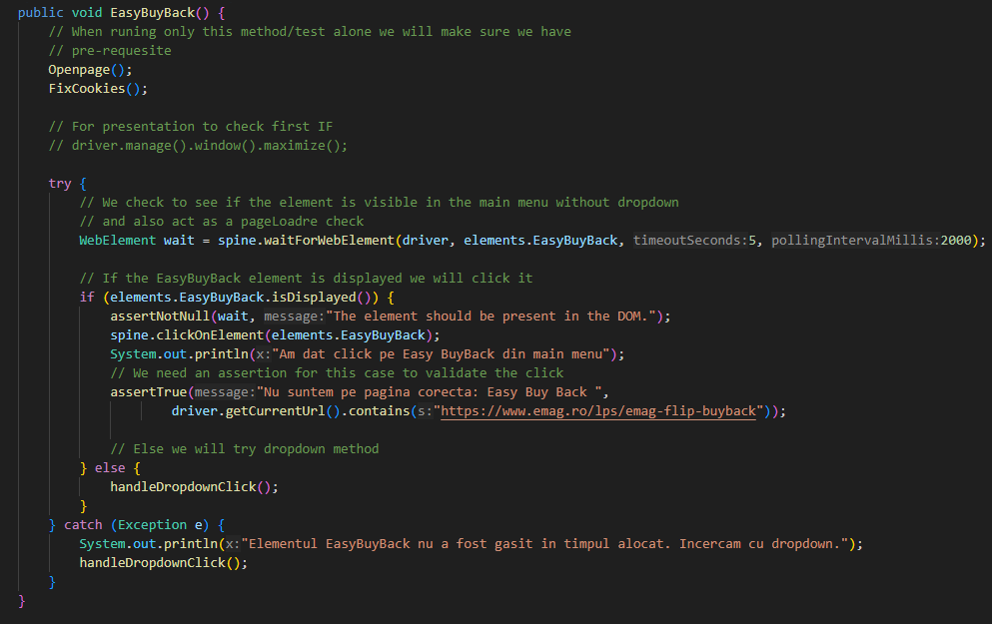
Now we can do some fun tests
How both methods will have two solutions each, a scenario for the dropdown and one without it
I will also showcase the same test written in 2 different ways
This goes back to the OOP notions
Also note that another interesting thing was the fact that the selectors would change depending on what test combinations you would do
Let’s start with EasyBuyBack test

Slide 27
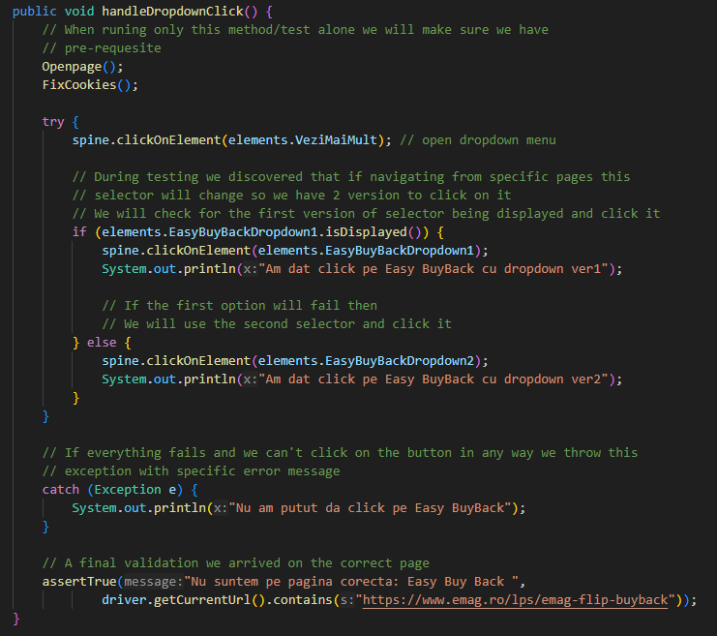
handleDropdownClick()
I realized i didn’t need OpenPage() and FixCookies(); here (i promised the code is final so i can’t change it i have to live with it)
The reason i didn’t move this method to spine is because is part of the test
The way i wrote the code for EasyBuyBack is to call another method to deal with the dropdown scenario
And we have 2 version cause during tests in some combinations the selector will change so i have a solution for each case under a try catch
And followed by a final assertion that we end up on the correct page in the end

Slide 28
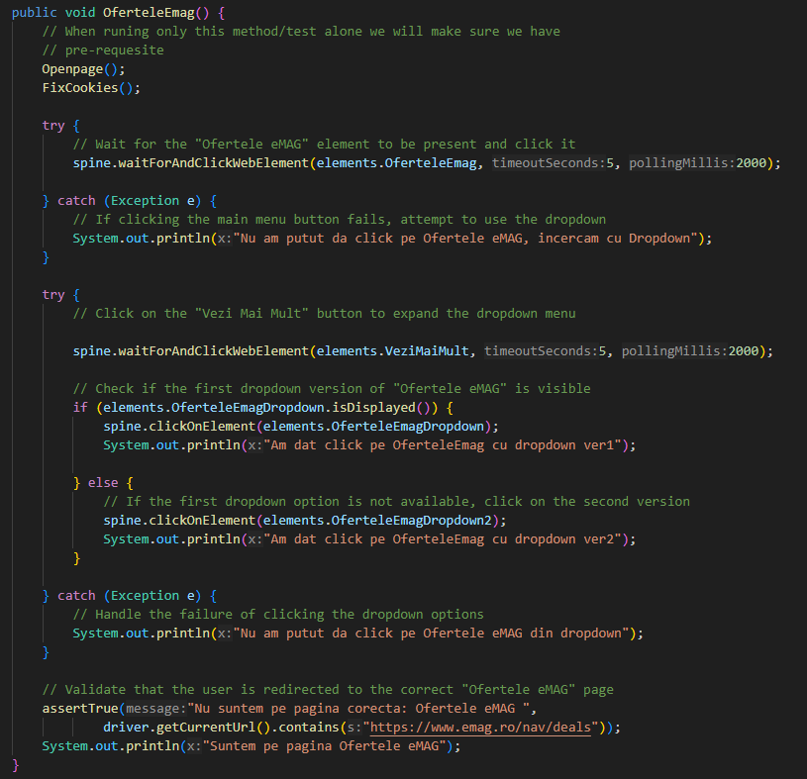
OferteleEmag()
Now you would think OferteleEmag() is just the same right? It should just bea copy paste adapted for the page needs but i asked myself, is that the only solution?
I was quite unhappy i had an extra method there to tell the truth and looking over the code i realised something
I don’t need an extra method
Now doesn’t this code look way shorter !? and we don’t have so much complexity with an extra method (and that makes me happy inside)
This is also helped by all the helper methods i created

Slide 29
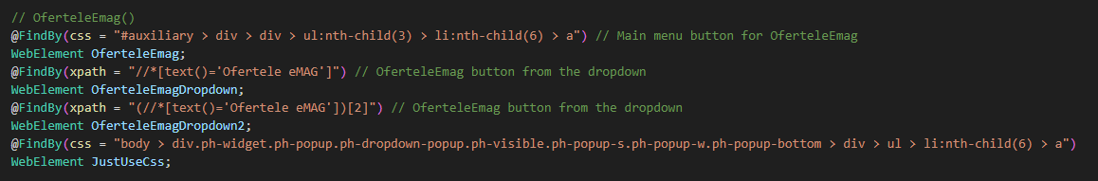
OferteleEmag2()
But as i finished writing the code for OferteleEmag() i realised something else
Now, i like that little cheeky IF i used for fixing the problem i found during testing, that the selector changes with some test combinations.
To understand why i had this problem we need to look at the selector i used
As you can see below you will notice that i was using Xpath with specific text
And as you figured it out already looking at the last element , sadly, on the first try to fix this, changing to cssSelecto was the first and last solution i had to try

Slide 30
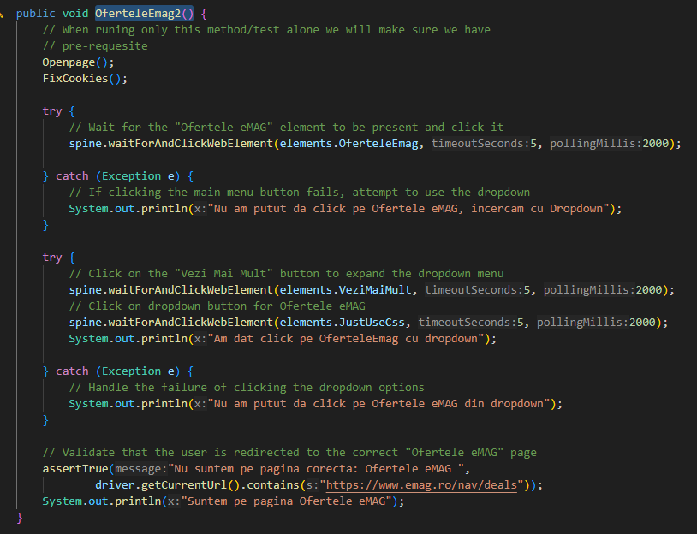
The IF is gone
Just like that i simplified even more the test using another selector
I tested the combinations i knew would change the selector and require the second variant to work
It was fixed, in all combination this solution worked
I arrived to this final solution because i looked at my code from outside the box so to speak
If someone came to me with this solution for a review what would i do!?
I would like to think i would ask myself, is this the best solution you found? Did you try to think about another approach !?
Then i immediately realised i was creating my own problem and fixing it myself with that IF

Slide 31
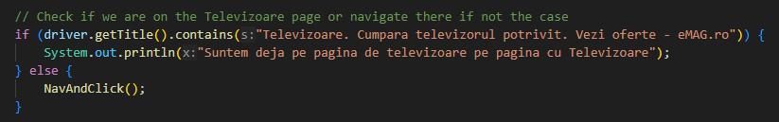
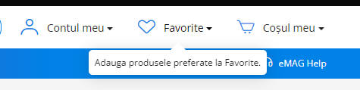
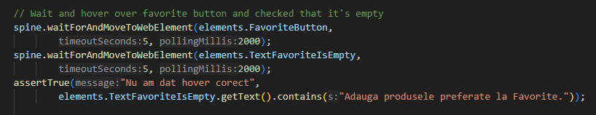
FavProduct()
The last method in Backbone.java
This method will use nav and click to go to televisoare page.
We will check favorite button is empty
We will add the first 2 products to favorite and navigate to favorite page

Slide 32
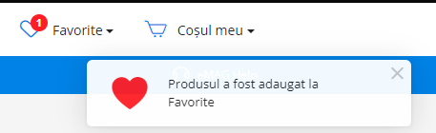
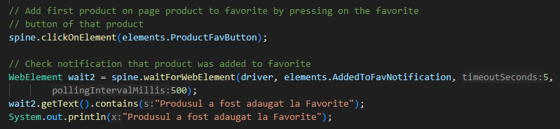
But while we do that we check that the first product is added successfully to favorite
This is one moment fluent wait shines
We are waiting for this pop-up and it’s very fast so we give spine.waitForWebElement a 5 seconds max wait time and pollingInterval of 500 ms, we check twice in 1 second
Never missed it in any test

Slide 33
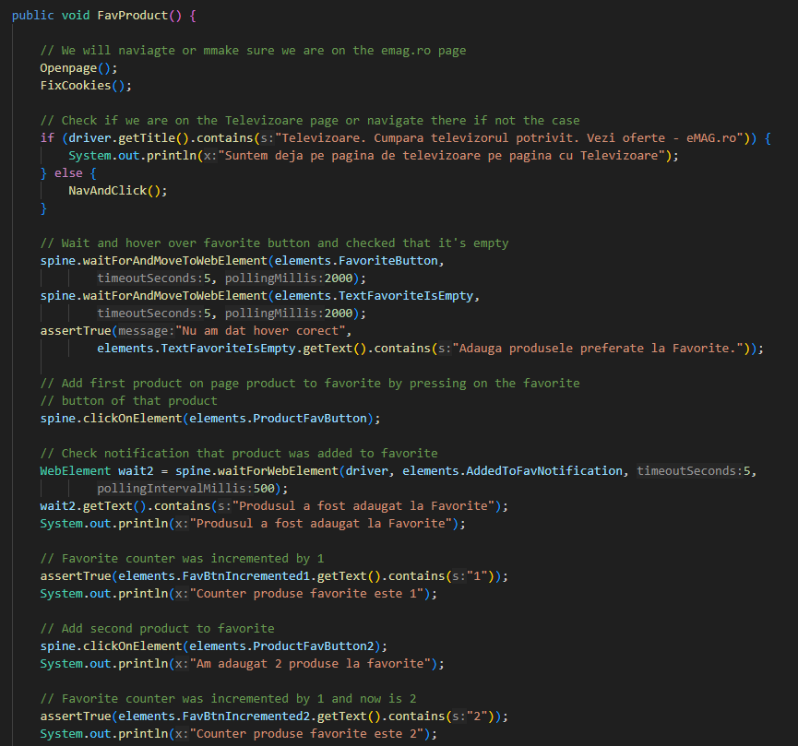
The rest of the method is quite long, we keep only one product in the favorite list and go all the way to checkout with it
We stop the test when we reach the login page
The challenges were finding suitable selectors and elements to combine with the wait methods to navigate all the way to checkout
It’s the biggest method in the code so far

Slide 34
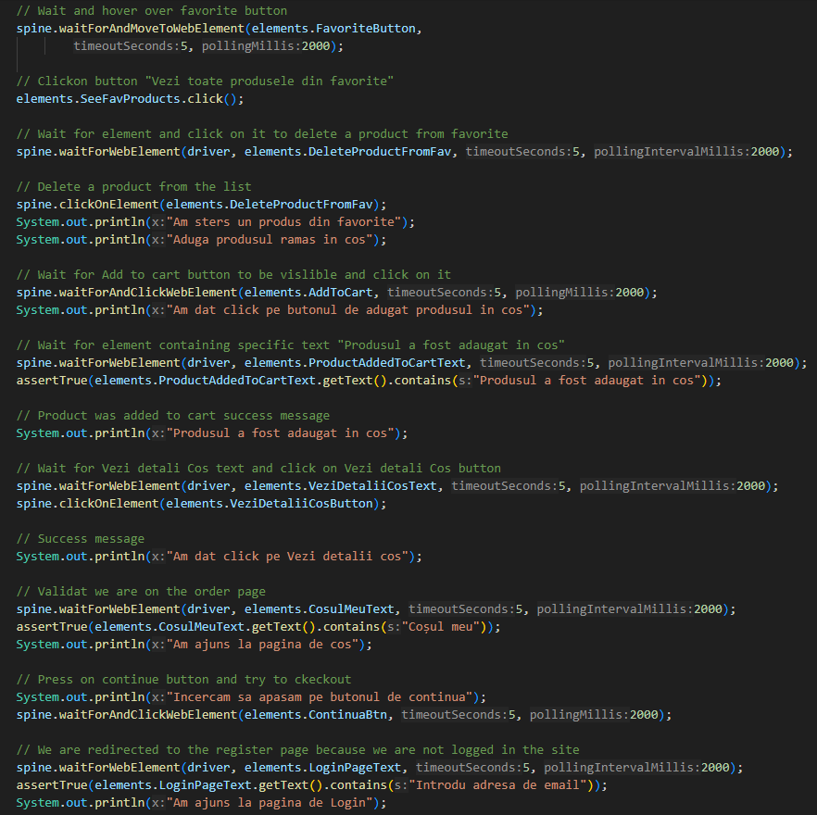
Notice how many waits and clicks we have
This was the main culprit for implementing comments, system.out.print and elements
We can debug fast what went wrong in the test. Let’s say we can’t find an element.
But we only have an xpath or css
What button is this?
What section of the code is it?
What was i doing exactly with that element?

Slide 35
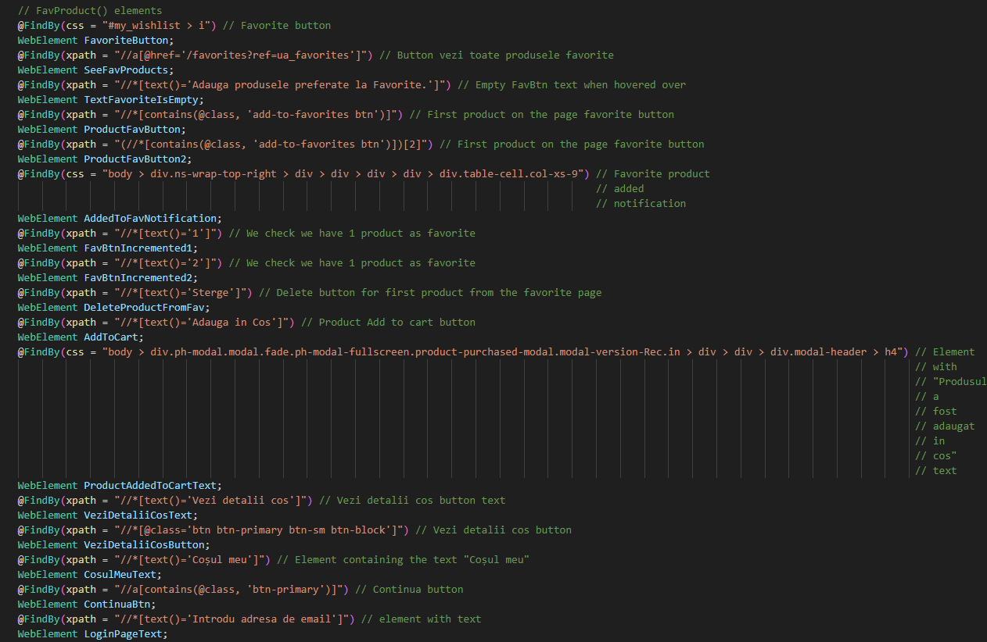
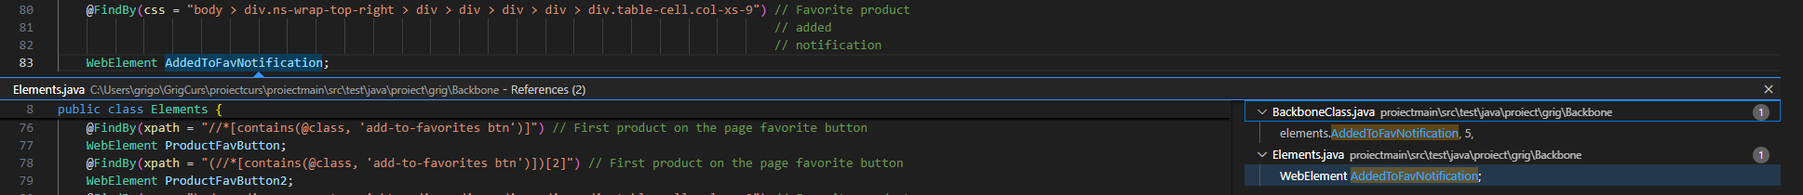
Depending on the selector you might or might not figure it out fast the what and where
Now when you have the css or xpath you go to elements and you find it
Can’t find @FindBy(css = "body > div.ns-wrap-top-right > div > div > div > div > div.table-cell.col-xs-9")
At a simple glance we can see what it was supposed to do
Favorite product added notification
WebElement AddedToFavNotification
And we can navigate exactly to the code that uses the element

Slide 36
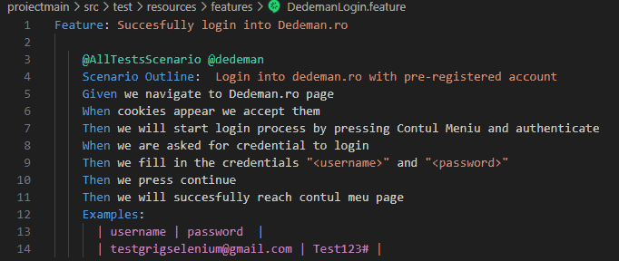
Time is running out
I will switch to VS and showcase the last test: Login on Dedeman.ro using BDD
We will also use a specific scenario type Scenario Outline
We will also showcase tags

Slide 37
Thank you for your time !
I hope you found at least some of the presentation interesting
My take away at the end of this journey (it really was a journey) is to always challenge yourself
If there is a will there is a way
We have many resources online to help us and if i can do it then 101% you can also do it
I wish i could tell you more about the project and the journey but time is short.
You can find the whole project on github it’s public and will remain public if you ever wish to check it out in more details
https://github.com/BalotGrigore/proiectcurs.git
I tried to also learn whenever i needed help for external sources not just use the code
I expect we will all get better once we spend more time in this field
If curious about the run times, in total, running all the tests we have exactly: 60s
Thank you again and good luck with your future projects hope you have fun like i did (almost all the time ;) there were times i wanted to just quit)

